Slide 1
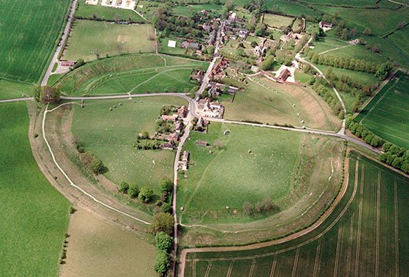
Avebury
Avebury is a stone circle which you can touch , have a picknick near
Near the stones. If you touch them they wont full down because they are stuck in the ground .
Caveman would use there rope to pull them with about ten or nine people.

Slide 2
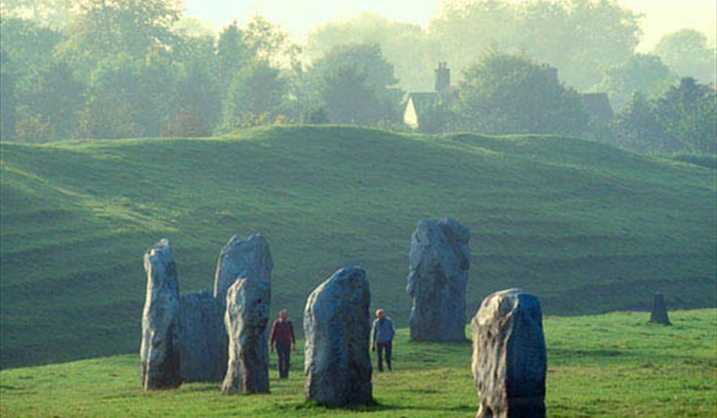
the
The cavemen had to get tuns of people because some people were on the other side they were digging a hole so then the people that were pulling it would be quiker.

Slide 3
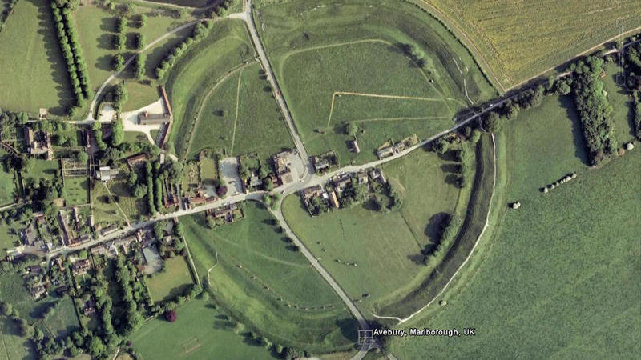
Stone henge
Stone henge is smaller than avebury .

Slide 4
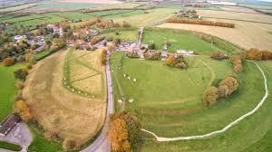
Avebury is a place where there are houses now but when it was first bilt there was no houses

